Slide 1
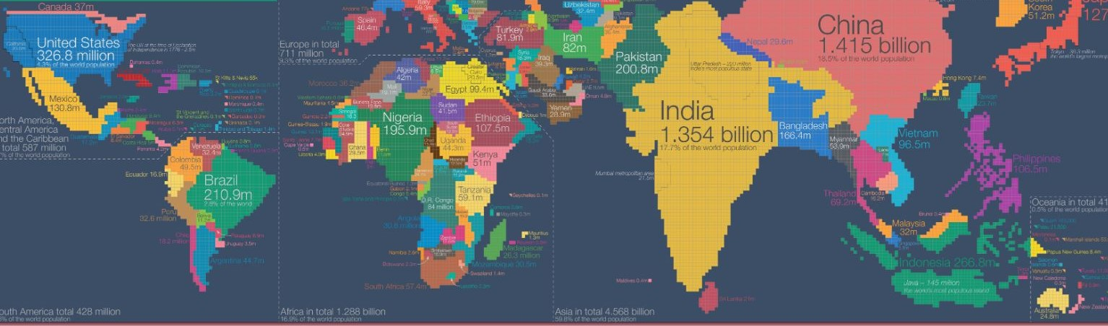
Weight Watchers
Who’s carrying the most of the weight?
Thinh Nguyen, Lalitha Vijayaraghavan, Diane Tata, and Walter Thomas

Slide 2
How prevalent is obesity on a global scale, and can the latest data help us get some perspective?
So we ask Questions,

Slide 3
Is obesity a problem only in the United States?
Is there a correlation between obesity and government healthcare expenditure?
Is there a prevalence of high blood pressure in obese countries?
Are men more obese than women globally?
Is there a high prevalence of obesity in countries with high Gross Domestic Product (GDP)?
Questions

Slide 4
Datasets:
World Bank
https://www.worldbank.org
Kaggle
https://www.kaggle.com/
World Data Bank
https://data.worldbank.org
DataWorld
https://data.world/
CSV File Import
Using :
Pandas
Numpy
Matplotlib

Slide 5
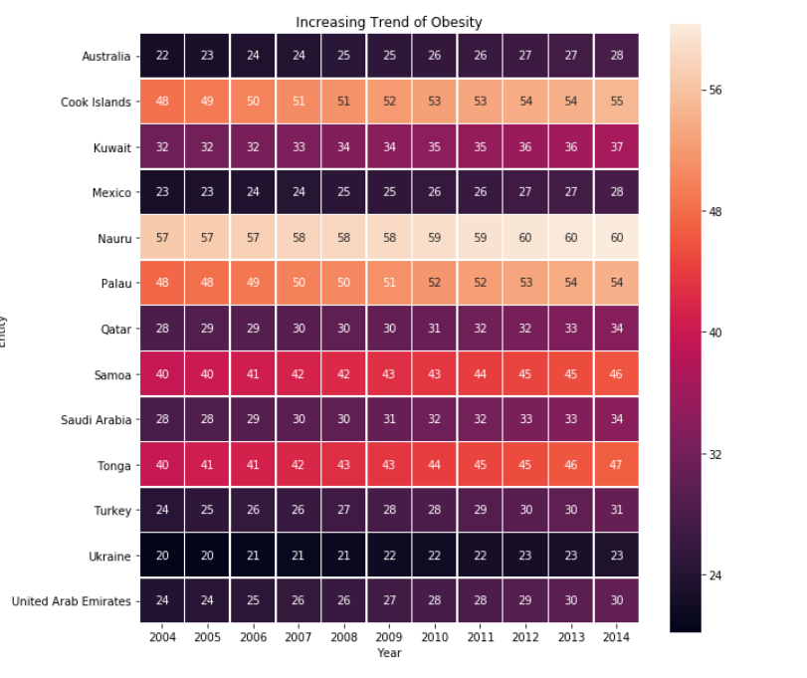
There is an increasing trend across the Globe.
Percentage of people obese

Slide 6
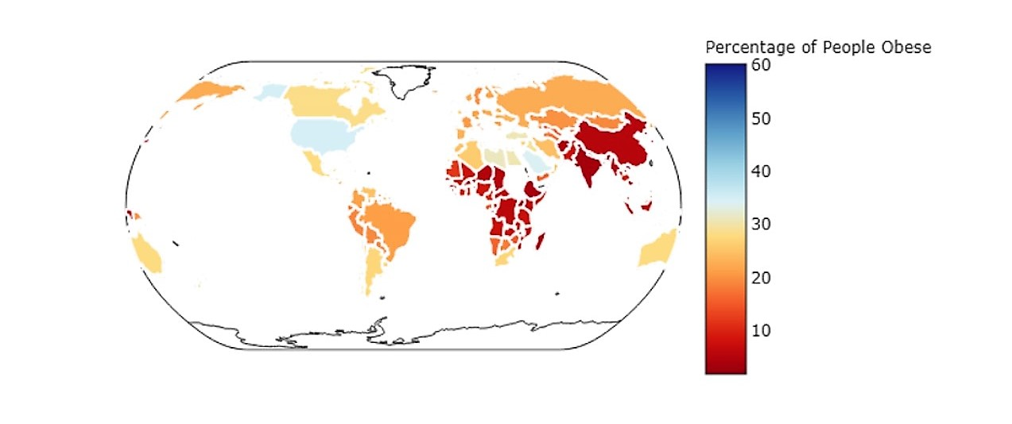
2014 Share of Obese People Around the World

Slide 7
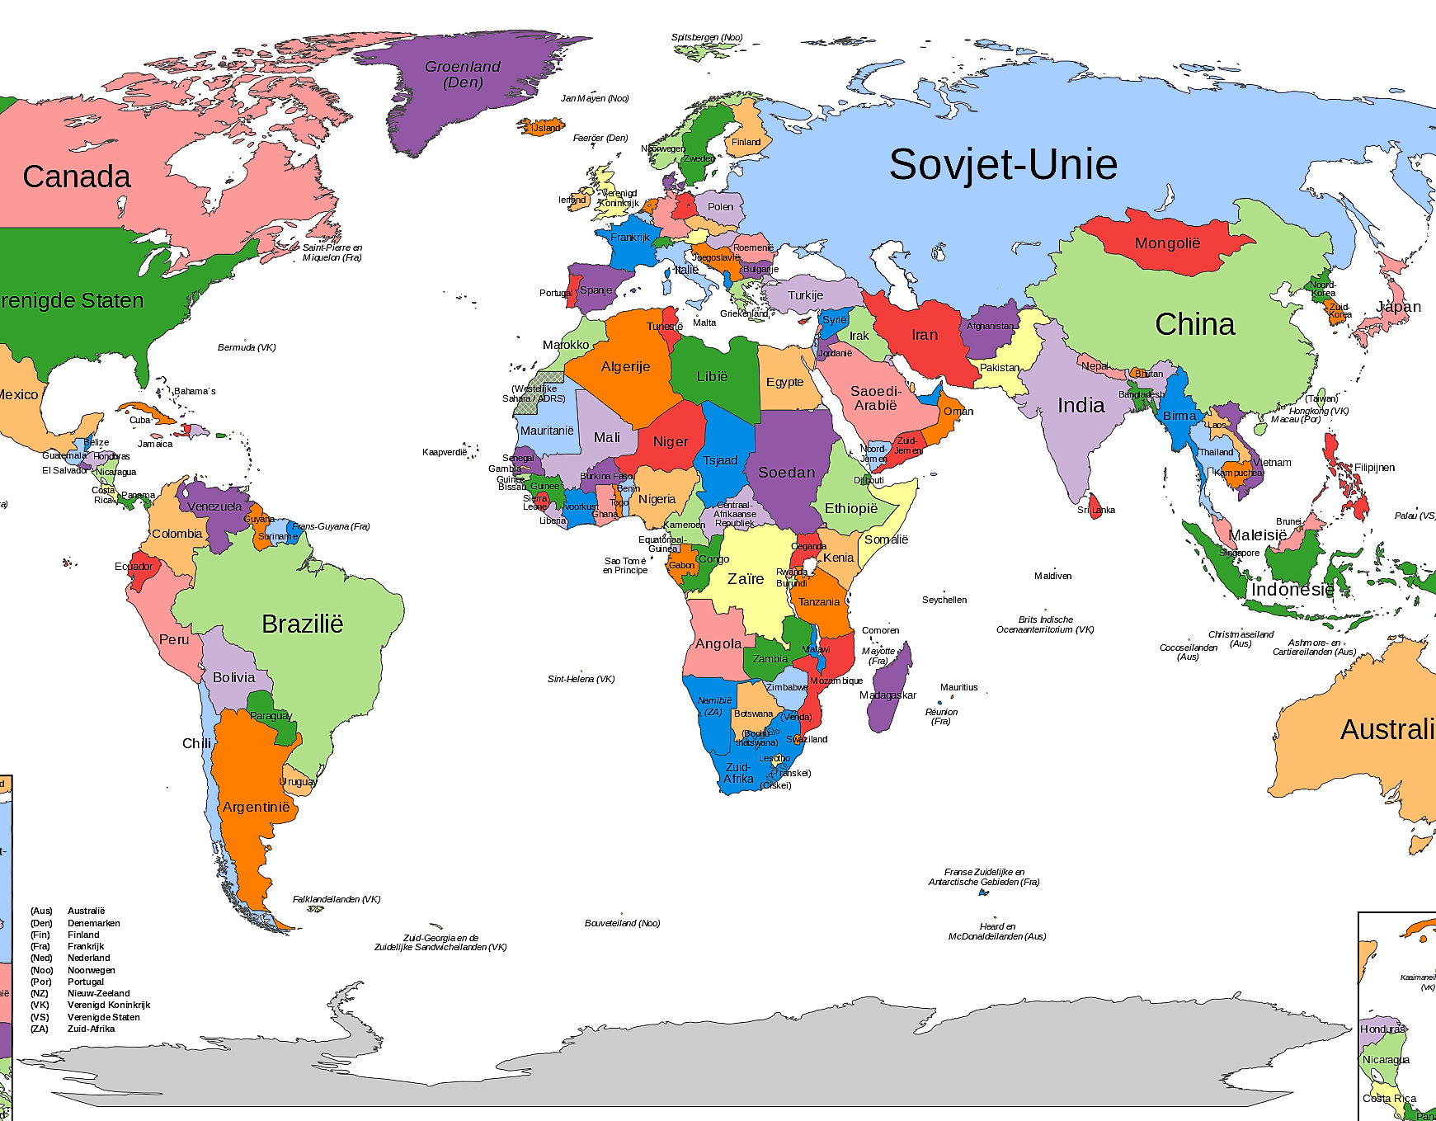

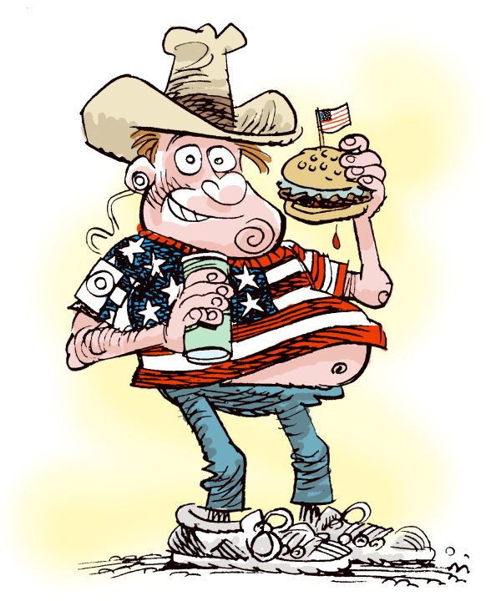
- Is obesity a problem only in the United States?
Top Ten Countries
10 Micronesia 44.4%
9 Kiribati 44.7%
8 Samoa 46.0%
7 Tonga 46.8%
6 Niue 48.4%
5 Tuvalu 50.1%
4 Marshall Islands 51.8%
3 Palau 54.2%
2 Cook Islands 54.9%
1 Nauru 60.3 %

Slide 8
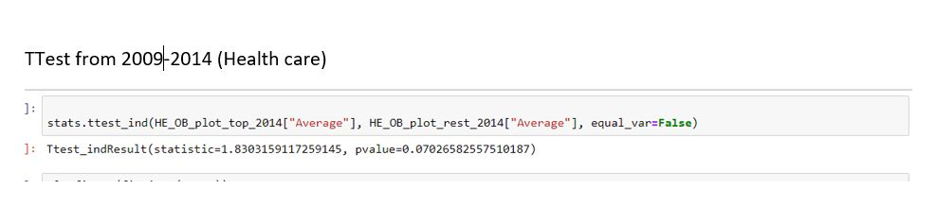
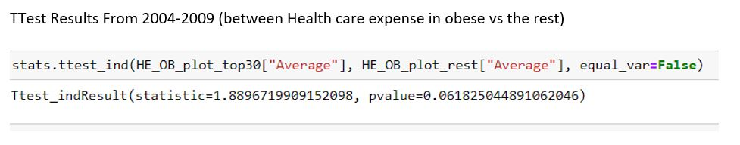
Is there a correlation between obesity and government healthcare expenditure(GHE)?
No. There is no direct correlation between obesity and GHE
Using Statistical Analysis:
30%
70%
Group 1
Group 2

Slide 9
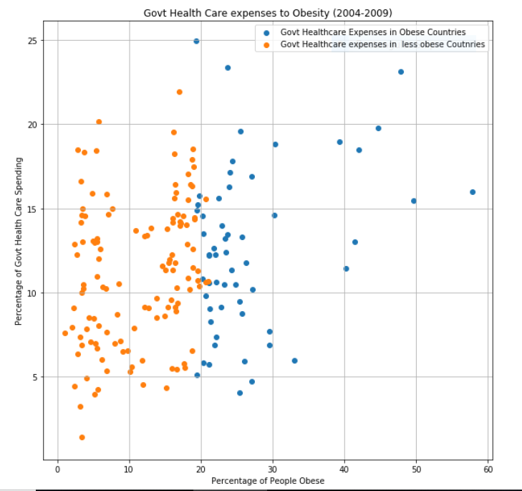
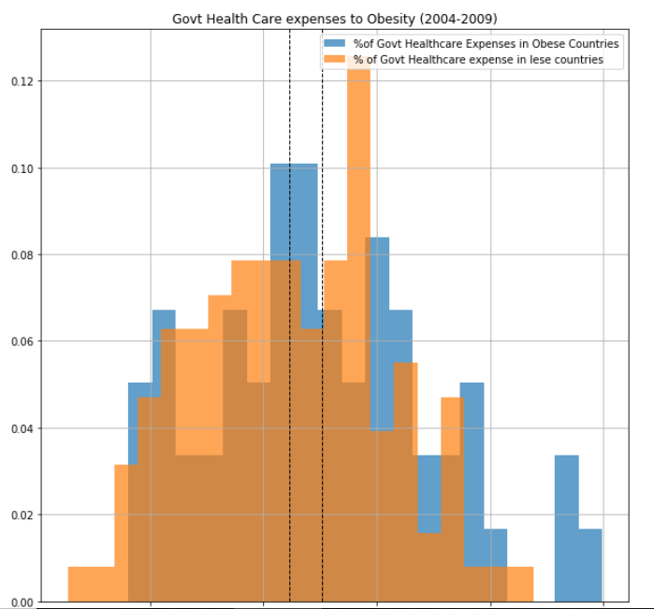
Government Healthcare Expense to Obesity across the world (2004-2009)

Slide 10
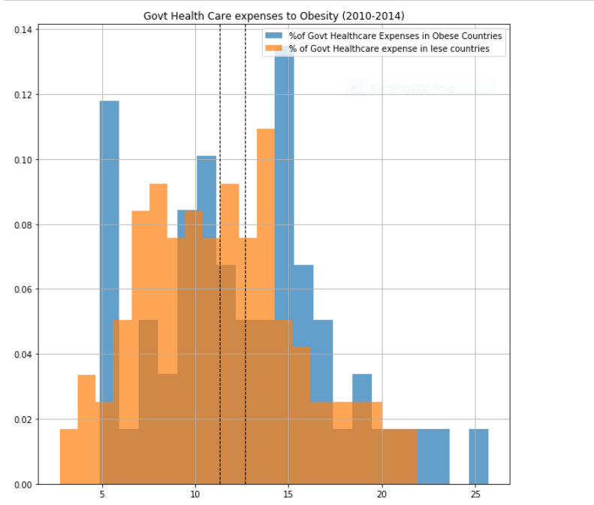
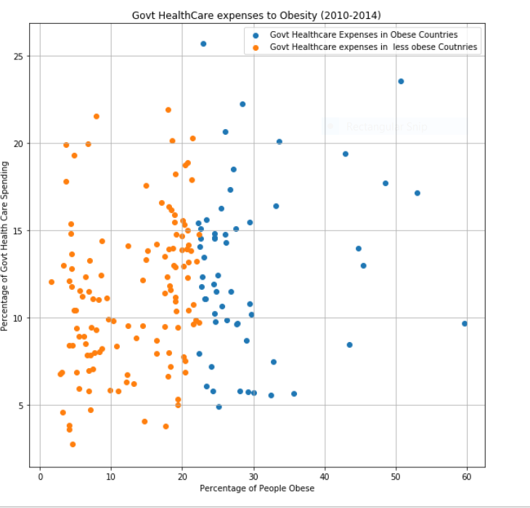
Government Healthcare Expense to Obesity across the world (2010-2014)

Slide 11
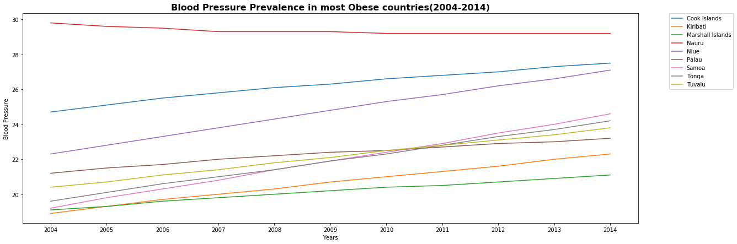
Is there a prevalence of high blood pressure in obese countries?
High Blood Pressure is prevalent in countries where obesity is also prevalent.

Slide 12
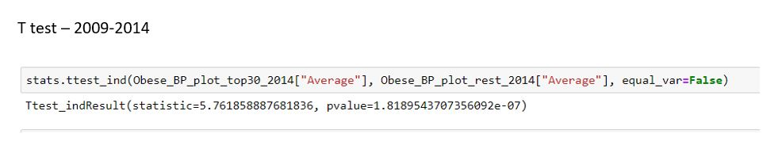
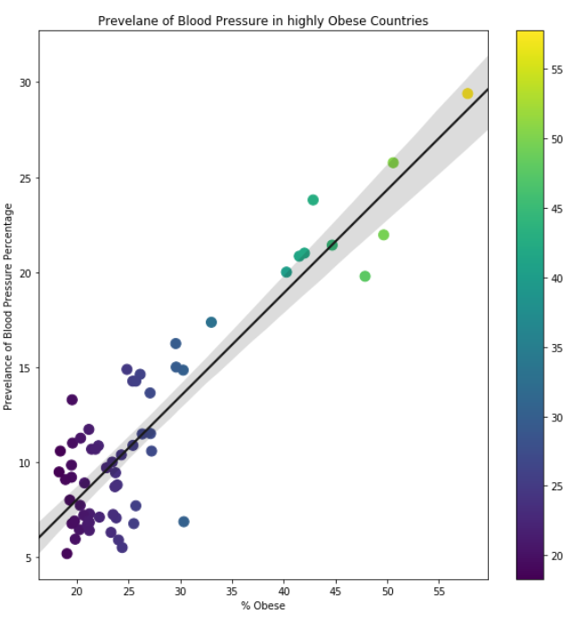
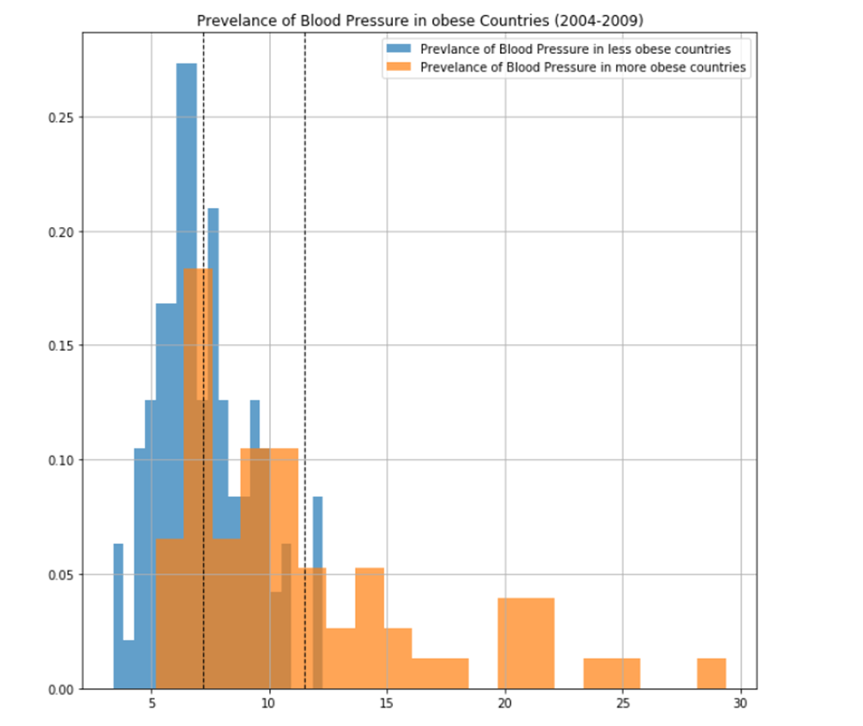
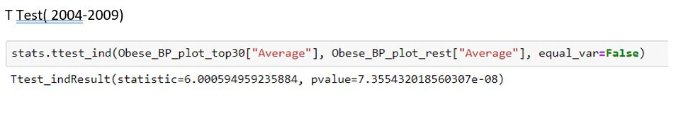

Slide 13
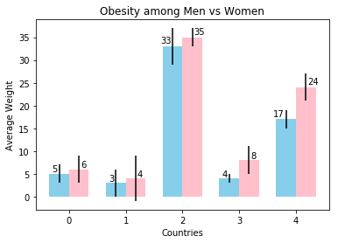
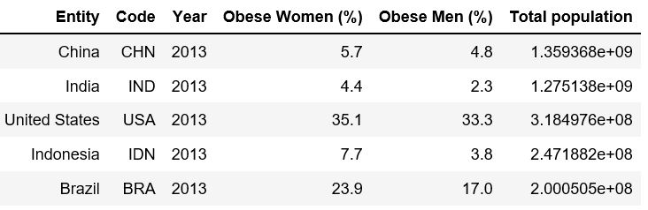
Are men more obese than women globally?
Top 5 Most Populated Countries
Using the most recent data given
Women
An the Answer is
Men
NO
Yes or

Slide 14
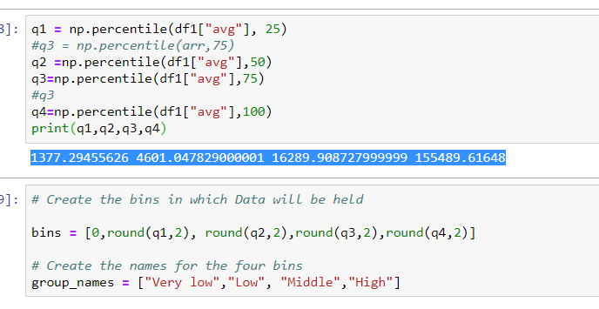

Slide 15
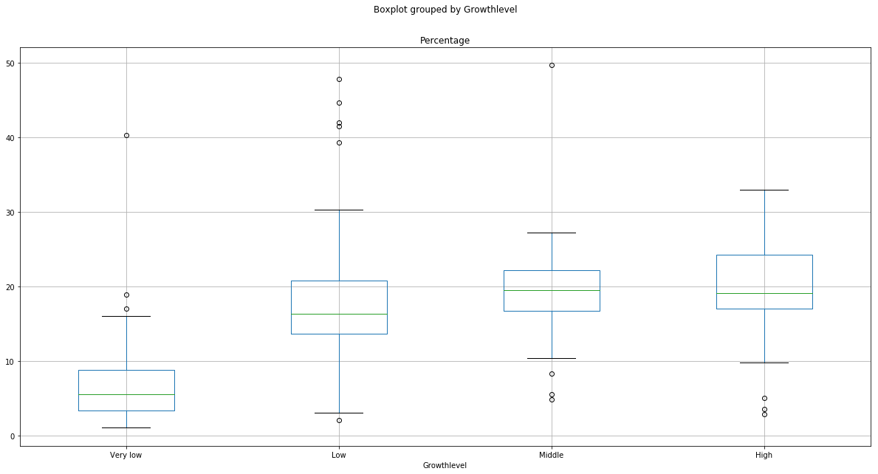



Is there a high prevalence of obesity in countries with high Gross Domestic Product (GDP)?
Percent obese
Countries with higher GDP have a higher % of obesity.

Slide 16
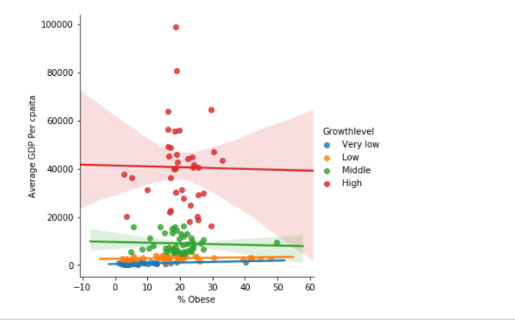
Is there a high prevalence of obesity in countries with high Gross Domestic Product (GDP)?

Slide 17
A brief Overall Analysis
Obesity is a global problem
Countries with smaller population has a higher proportion with people who are overweight.
Countries with higher GDP have a higher % of obesity. Countries with more money to spend on things they produce are fatter than others that don’t.
Women more obese than Men in the top most populated countries in the world.
High Blood Pressure is prevalent in countries where obesity is also prevalent.
Although being obese has heath side-effects . There is no direct correlation between obesity and GHE.

Slide 18
Our Conclusion:
- Limitations
- The Dataset we found most recent was 2014 – 1996
-
Any Questions?

Slide 19
Weight Watchers
Who’s carrying the most of the weight?
Thinh Nguyen, Lalitha Vijayaraghavan, Diane Tata, and Walter Thomas

